Slide 1
HRM & JOB ANALYSIS
Notes:
Course Instructor - Dr. Parikshit Joshi

Slide 2
OBJECTIVES OF HRM
To provide right types of personnel for right jobs at the right time.
To provide right kind of training to increase their productivity.
To ensure effective utilization of human resources.
To identify and satisfy needs by offering monetary and non monetary rewards.
To achieve and maintain high morale among employees for securing better human relations.

Slide 3
SCOPE OF HRM
1.Personnel Aspect: Concerned with recruitment, selection, maintenance, appraisal, promotion, incentives, productivity etc.
2. Welfare Aspect: Concerned with working conditions and amenities such as canteens, crèches, housing, schools, recreation etc.
3. Industrial Relations Aspect: Trade unions, negotiation, settlement of industrial disputes, joint consultation and collective bargaining.

Slide 4
FUNCTIONS OF HRM
Functions of HRM
Managerial
Planning
Organising
Directing
Controlling
Operative
Recruitment
Selection
T & D
Compensation
Motivation
Personnel Records
Industrial relations
Seperation
Advisory
Advice to Top management
Advice to departmental Heads

Slide 5
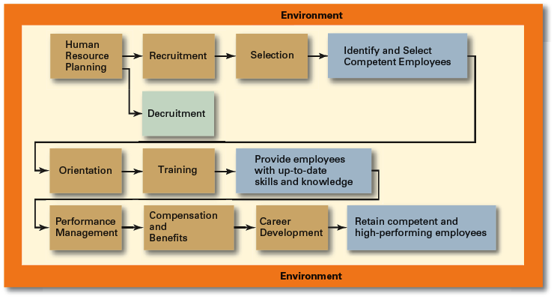
HUMAN RESOURCE MANAGEMENT PROCESS
Copyright © 2010 Pearson Education, Inc. Publishing as Prentice Hall
10–<number>

Slide 6
JOB ANALYSIS
A job may be defined as an assignment of work, a set of duties, responsibilities and conditions that are different from those of other work assignments.
Job Analysis is detailed and systematic study of jobs to know the nature and characteristics of people to be employed for each job.
It has two components:
Job description &
Job Specification

Slide 7
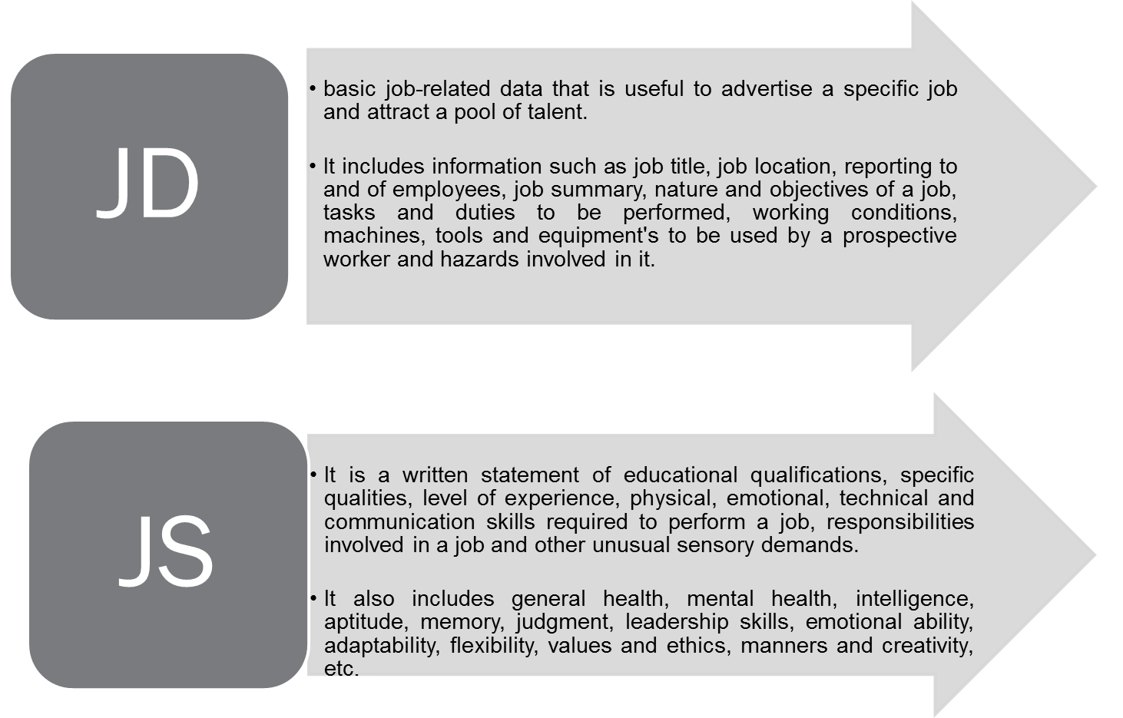
JOB SPECIFICATION & JOB DESCRIPTION

Slide 8
JOB ANALYSIS: A BASIC HUMAN RESOURCE MANAGEMENT TOOL
Staffing
Training and Development
Performance Appraisal
Compensation
Safety and Health
Employee and Labor Relations
Legal Considerations
Tasks
Responsibilities
Duties
Job Descriptions
Job Analysis
Job Specifications
Knowledge
Skills
Abilities

Slide 9
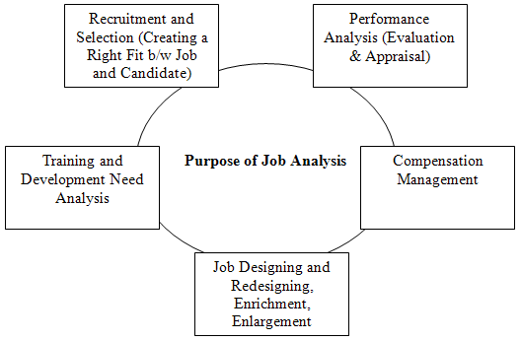
THE USE OF JOB ANALYSIS

Slide 10
BUSINESS PROCESS
REENGINEERING

Slide 11
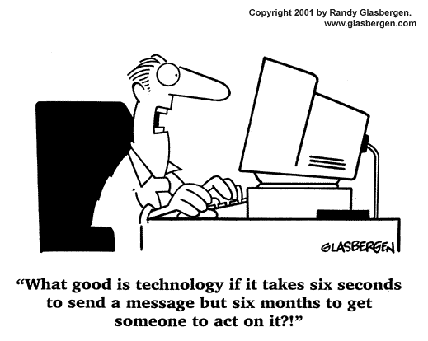

Slide 12
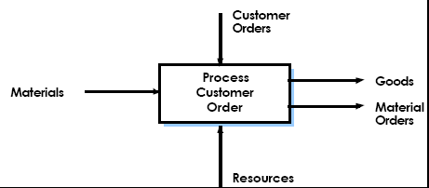
WHAT IS A BUSINESS PROCESS?
“A business process is a collection of activities which together produce something of value to a customer”
– e.g. Customer Order Entry

Slide 13
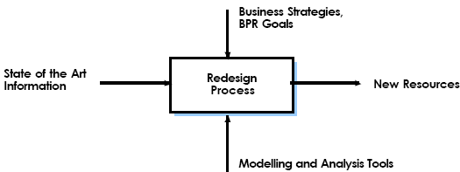
DEFINITION
Reengineering is the fundamental rethinking and radical redesign of business processes to achieve dramatic improvements in critical, contemporary measures of performance, such as cost, quality, service, and speed.

Slide 14
WHAT TO REENGINEER?
BPR changes processes, and
not
functions, departments, geographies or tasks.
Notes:
Selecting a Methodology for BPR

Slide 15
WHAT IT IS NOT?
Reengineering is not reorganizing.
  Modifying how an organization is structured and redesigning an organization’s business processes are two different things.
  An organizational structure should be designed so that it best supports redesigned business processes.
Reengineering is not downsizing either.
  Downsizing focuses on the reduction of workforce to achieve short-term cost savings.
  Reengineering, on the other hand, focuses on rethinking from the ground up, finding more efficient ways of working including eliminating work that is unnecessary.

Slide 16


REASONS FOR REENGINEERING
Old Era
New Era
High Demand
High Competition
Efficiency
Control
Innovation
Speed
Service &Quality

Slide 17
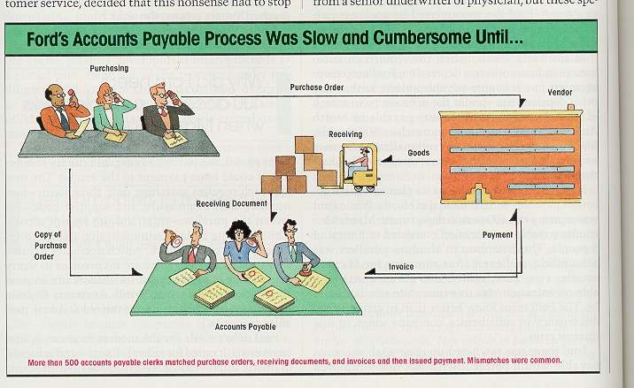
EXAMPLES

Slide 18
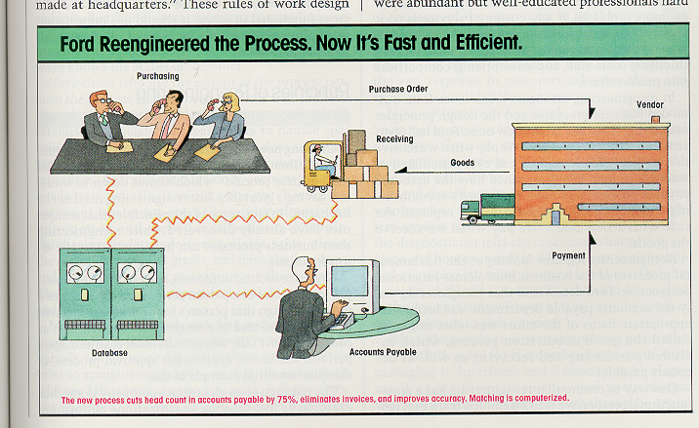
EXAMPLES

Slide 19
BENEFITS OF REENGINEERING
The rewards of reengineering are many including:
  empowering employees;
  eliminating waste, unnecessary management overhead, and obsolete or inefficient processes;
  producing often significant reductions in cost and cycle times;
  enabling revolutionary improvements in many business processes as measured by quality and customer service; and
  helping top organizations stay on top and low-achievers to become effective competitors.

Slide 20


